Slide 1

Show some sensitivity!
Using motion tracking to improve unconscious measures
Khen Heller under the supervision of Craig S. Chapman and Liad Mudrik

Slide 2

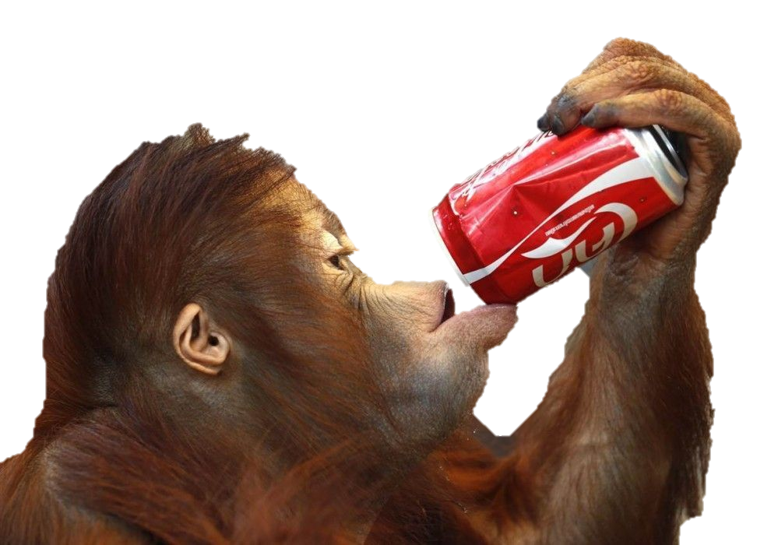


Unconscious processing
Stimuli
Perceived?
Affects Behavior?
Conscious
Unconscious

Slide 3
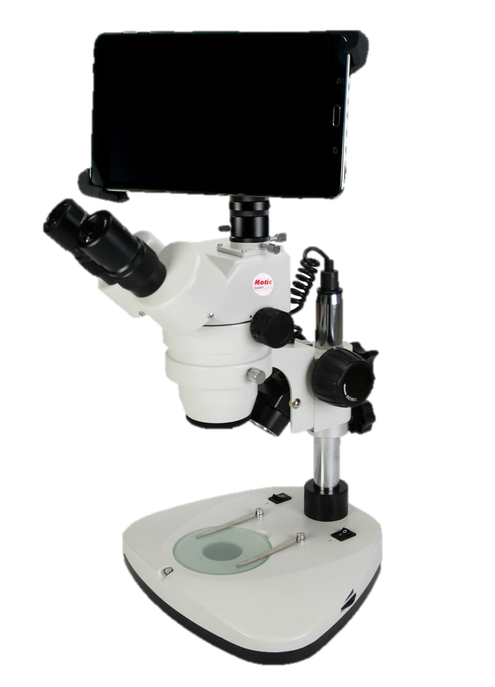

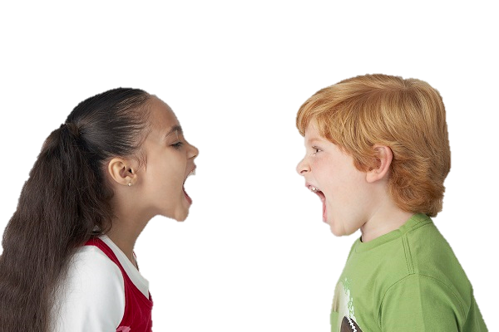
Improving Sensitivity
Problem: Common measure can’t pick up the effect
Consequence: controversy
Solution: Increasing the effect size
Implementation: Sensitive measures
Notes:
Some say:
Unconscious processing can perform high level functions and have a small but existing affect on behavior,
Others say:
It is negligible, and the parts of it that can be found can be explained by conscious influence.

Slide 4
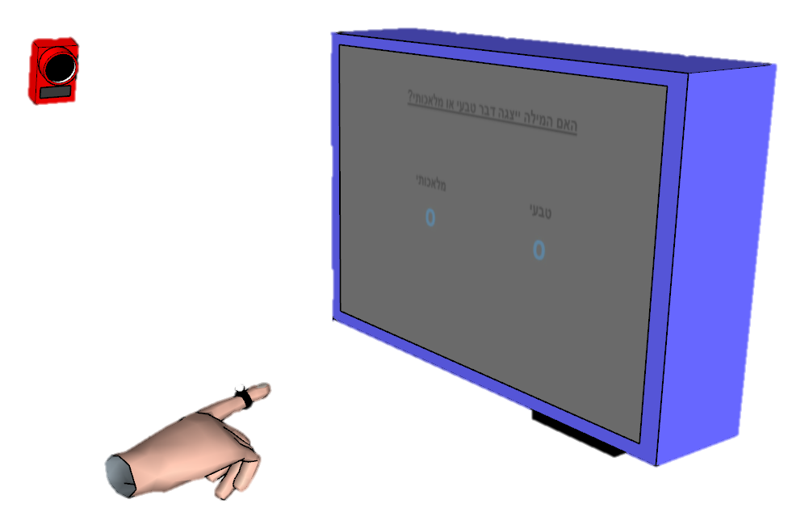
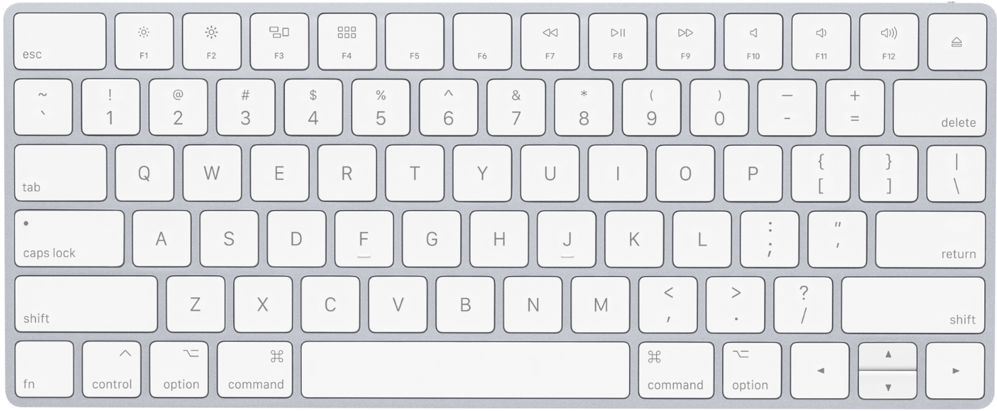
Keyboard VS. Motion tracking
Single value
Post decision
“Poor” – RT, accuracy
Continuous
Online
“Rich” – RT, onset, MAD, velocity…
Notes:
Translate this analogy to our research

Slide 5
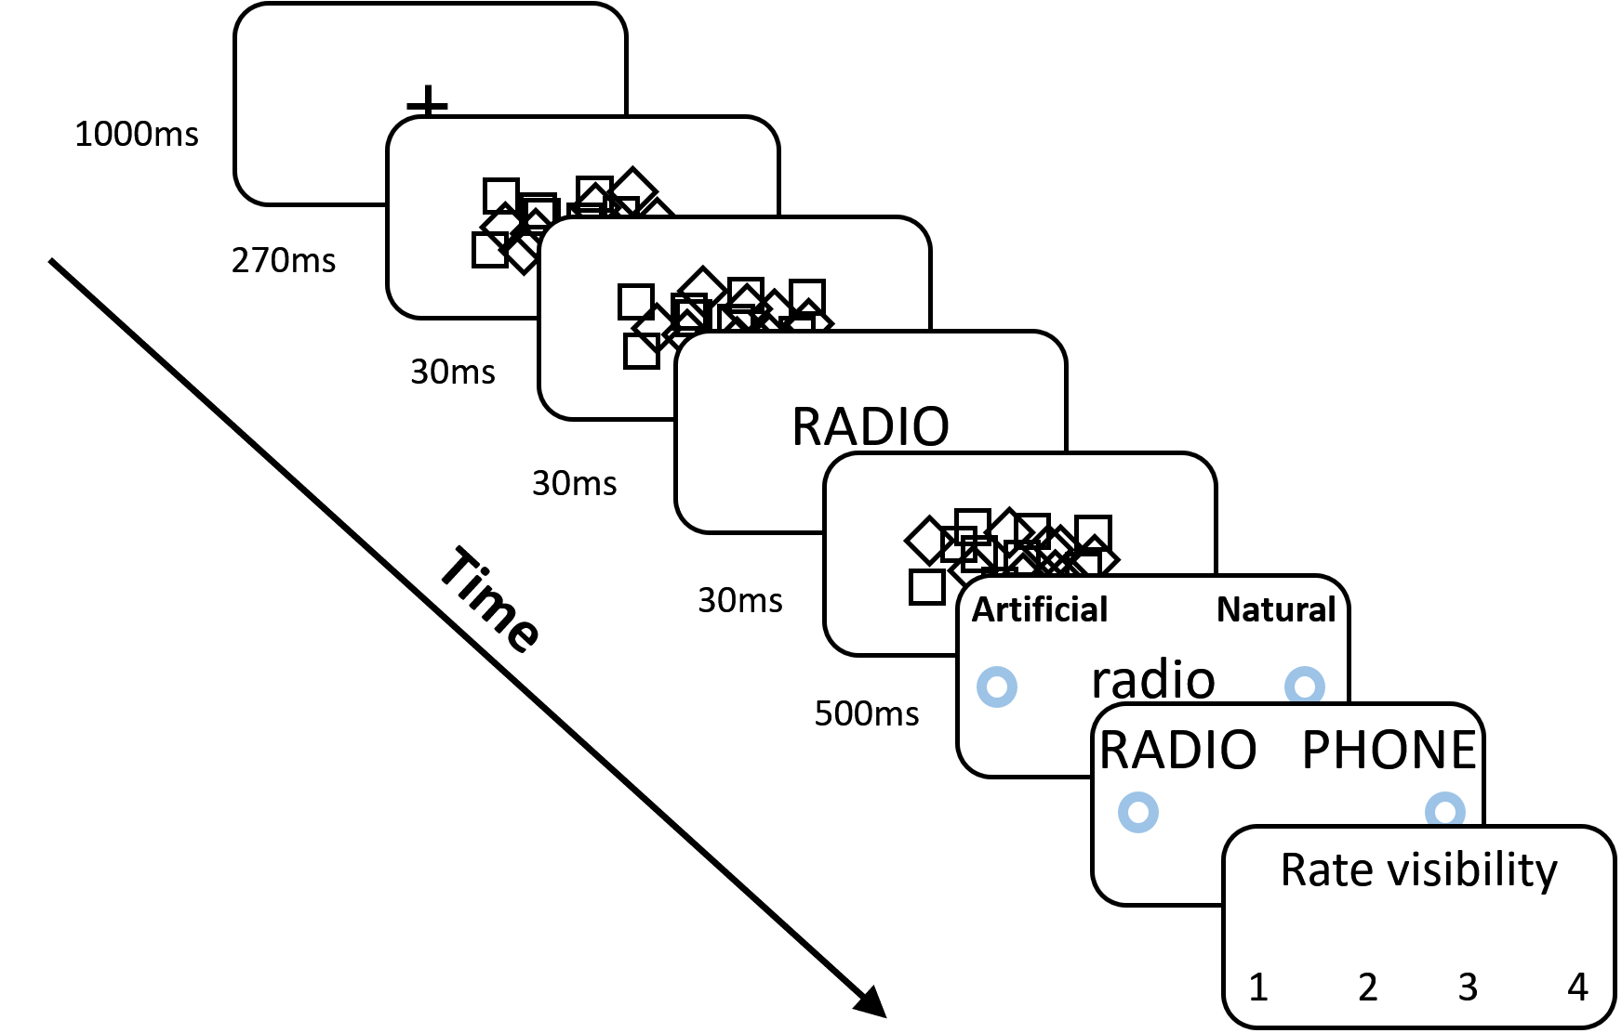
Our Paradigm
Notes:
Prime is shortly displayed between very salient masks, which renders it invisible.

Slide 6
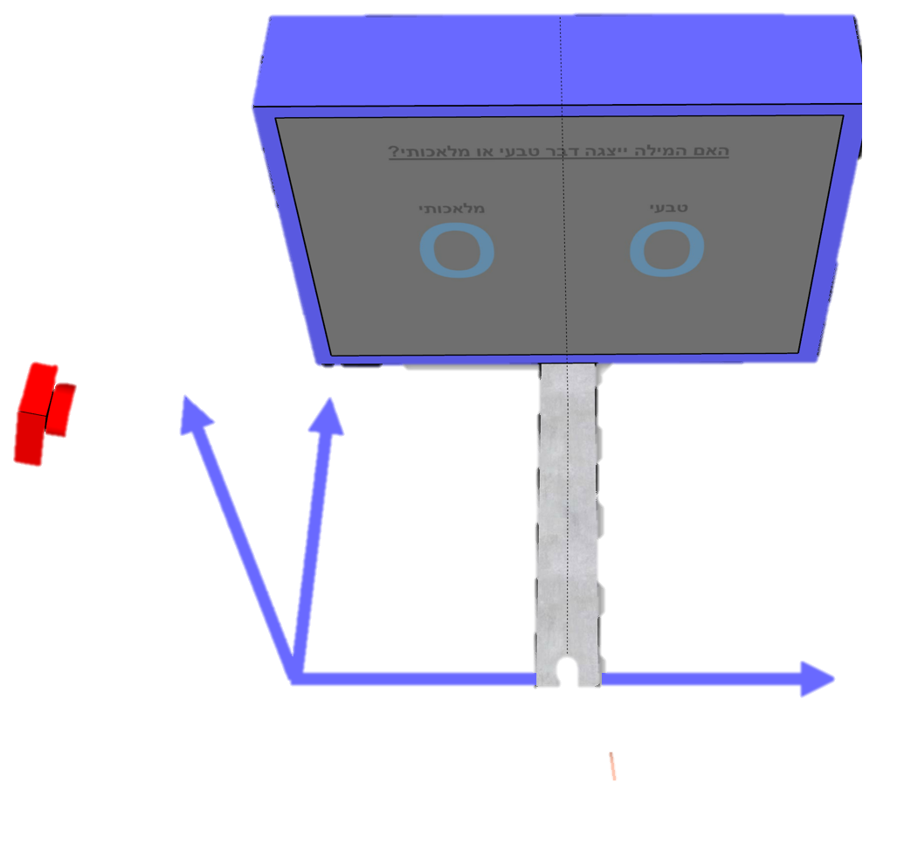
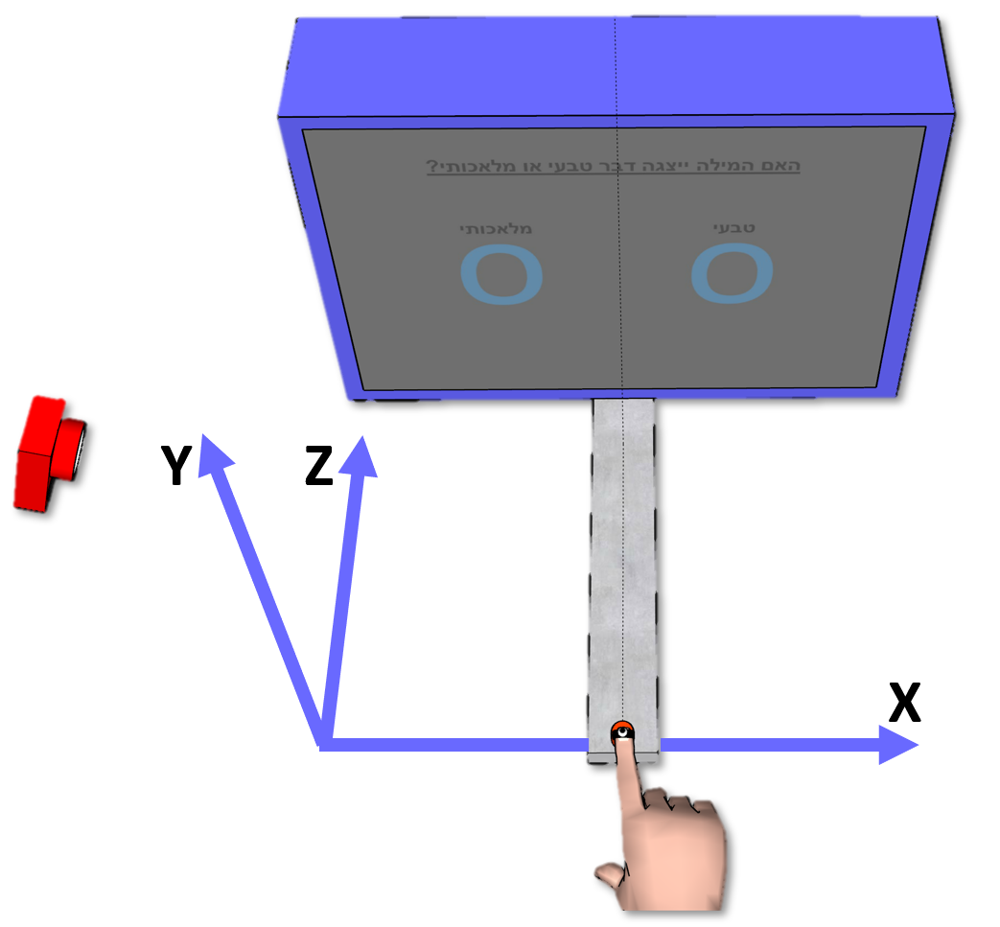
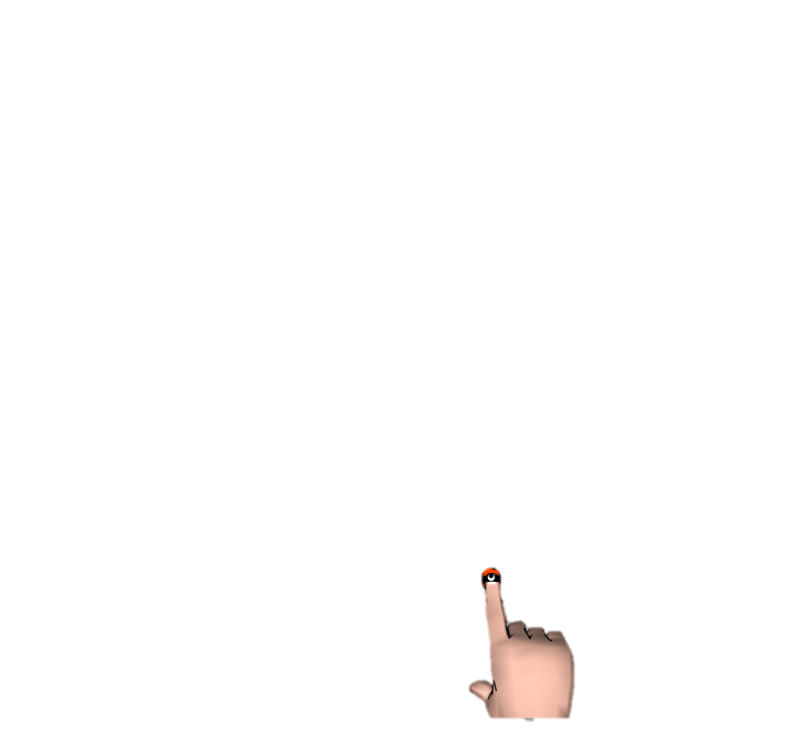
Conditions
Congruent - Same word
Incongruent - Different word
Different category
Congruency effect = Con - Incon
Artificial Natural
radio
TREES

Slide 7
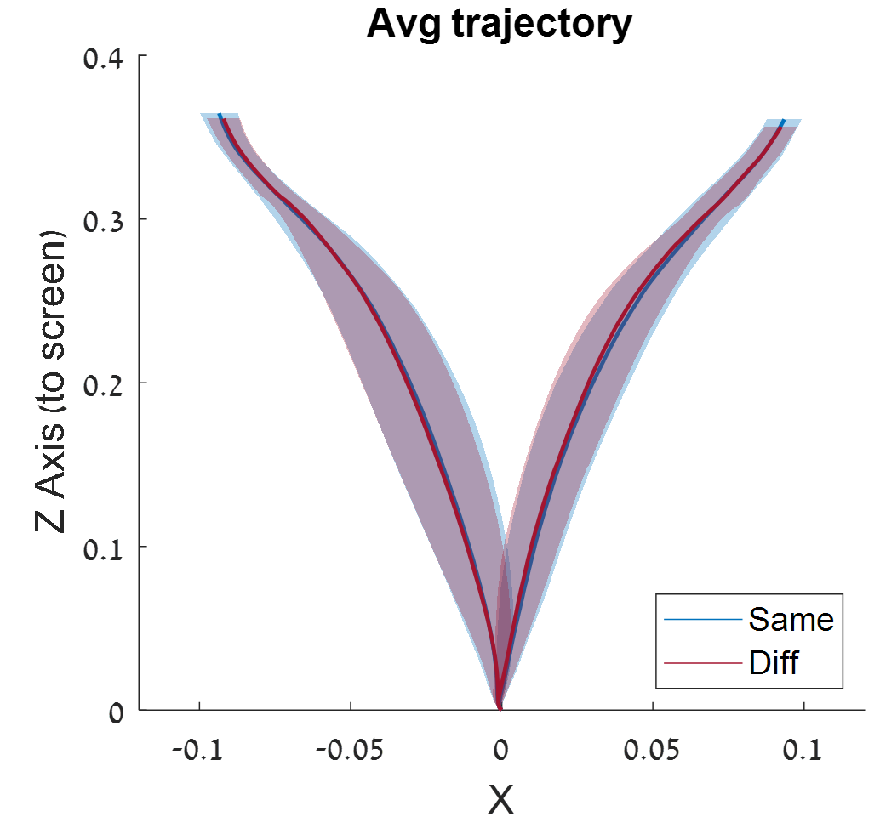

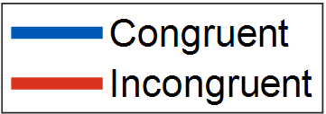
Pilot 1
Long response time
N = 10

Slide 8
Evidence Accumulation
Artificial Natural
TREES
radio
Time

Slide 9
Evidence Accumulation
Artificial Natural
Long response time
TREES
radio
Artificial
Evidence
Natural
Time

Slide 10
Evidence Accumulation
Artificial Natural
Long response time
TREES
radio
Artificial
Evidence
Natural
Time
RT Limit

Slide 11
Evidence Accumulation
Artificial Natural
Long response time
TREES
radio
Reaching
Artificial
Evidence
Natural
Time
Decision
RT Limit

Slide 12
Evidence Accumulation
Artificial Natural
Long response time
TREES
radio
Reaching
Artificial
Evidence
Natural
Time
Decision
RT Limit

Slide 13
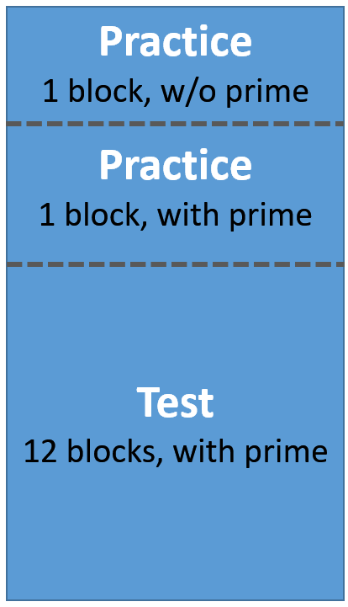
Pilot 2
Shorter RT Limit – 750ms
Added practice to improve RT
Increase target size
N = 11

Slide 14
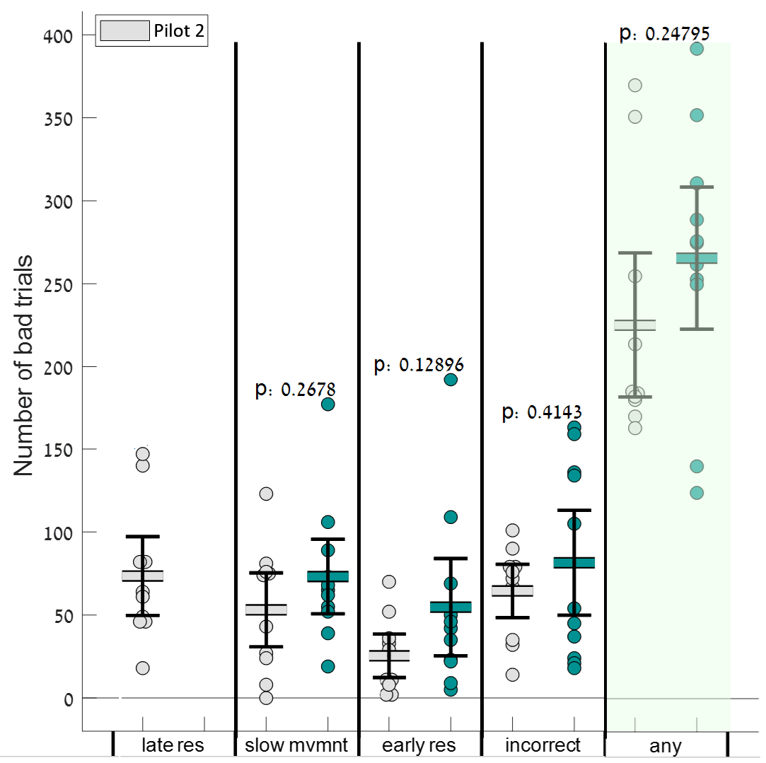
Pilot 2
~220 bad trials out of 480
Many incorrect answers
Bad response timing

Slide 15
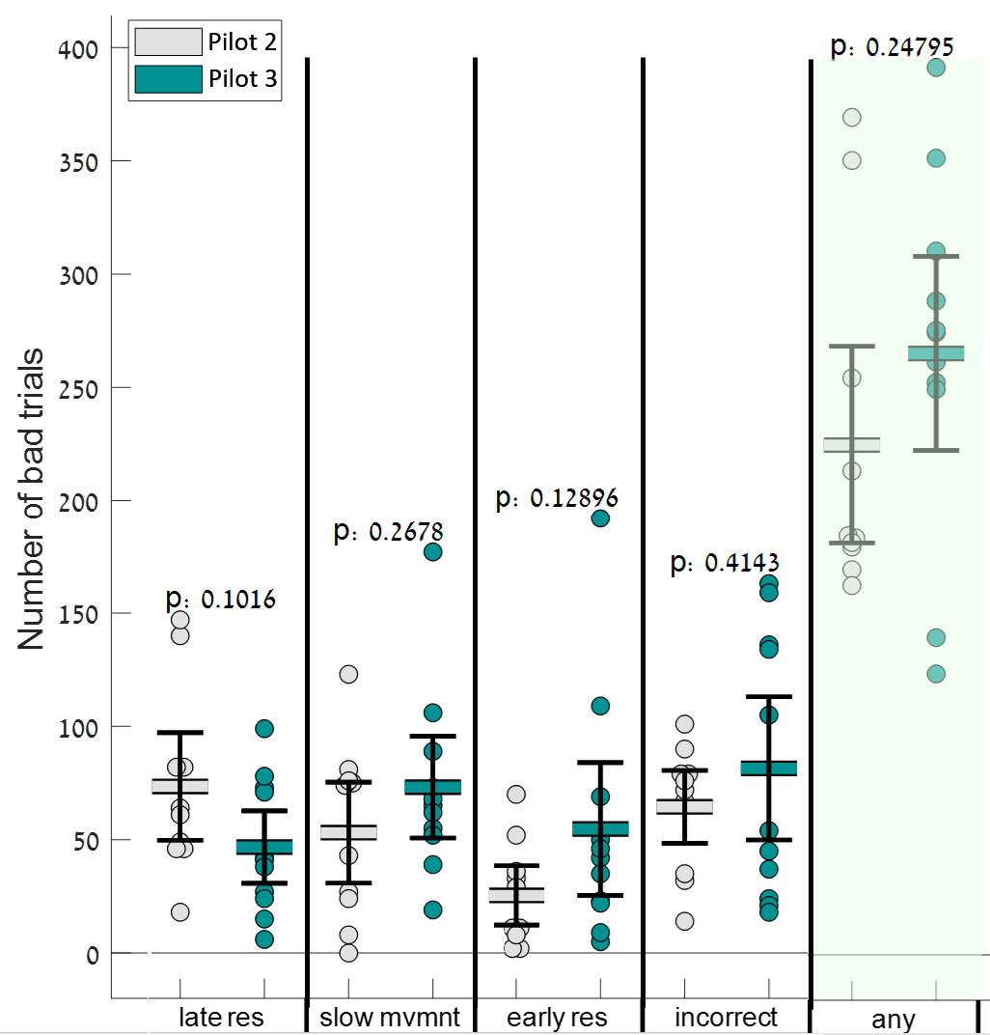
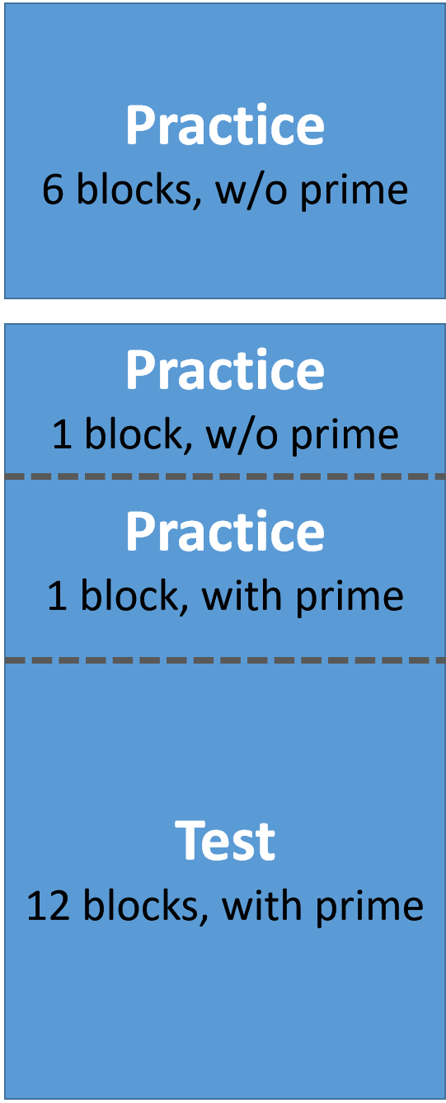


Pilot 3
Increase training
Right?
Increase training
Right?
Day 1
WRONG!
“Over” training
Day 2
N = 10
Notes:
Subjects were trying so hard to make fast responses,
That their responses got too fast.
This is also probably the reason why the number of incorrect answers increased: fast responses were favored on the expanse of correct responses.

Slide 16
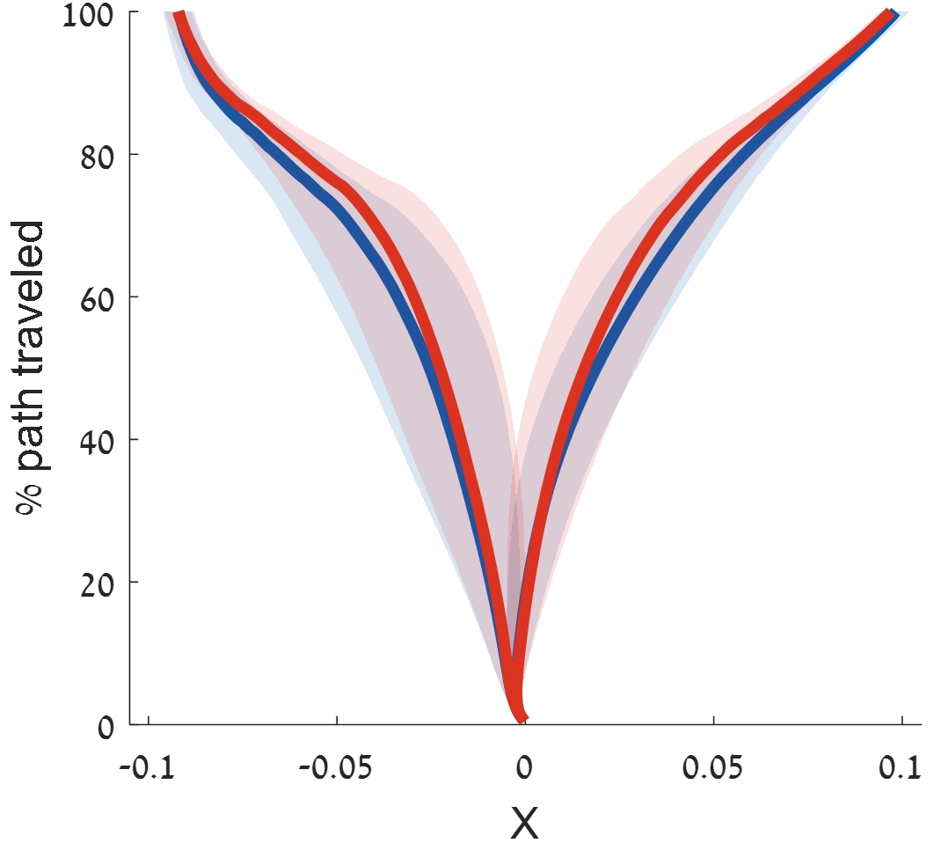
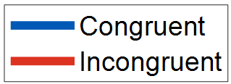
Results
Pilot 2
Pilot 3
How do we quantify it?

Slide 17

Trajectory Processing
Fill in missing data
Low pass filter
Center trajectories
Find movement onset and offset
Normalize
Notes:
Meerkat
סוריקטתה

Slide 18
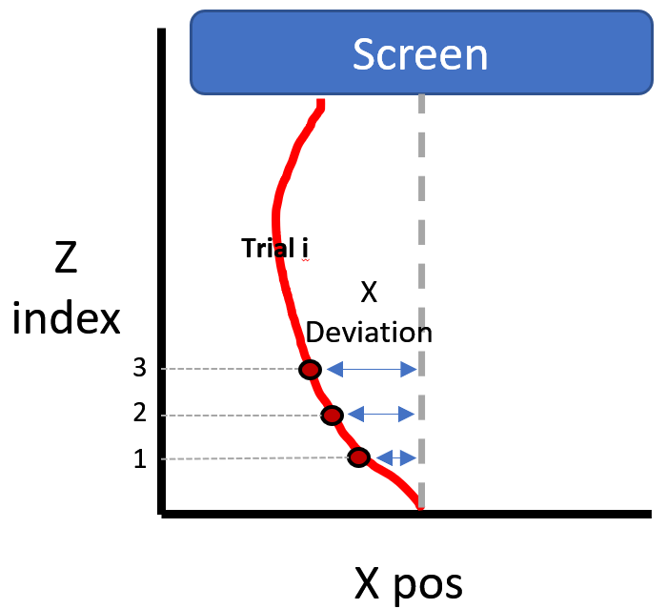
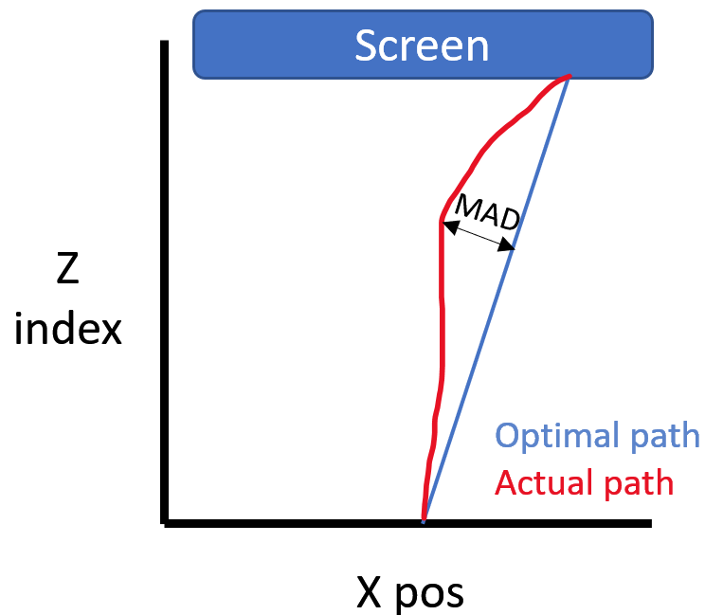
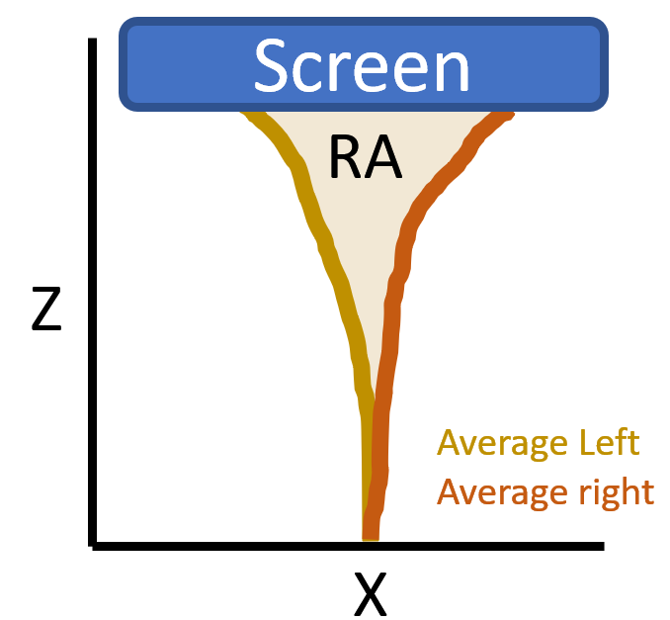
Quantifying The Effect
X Coordinate MAD Reach Area

Slide 19
Extracting parameters
Reach Area
= Congruency Effect

Slide 20
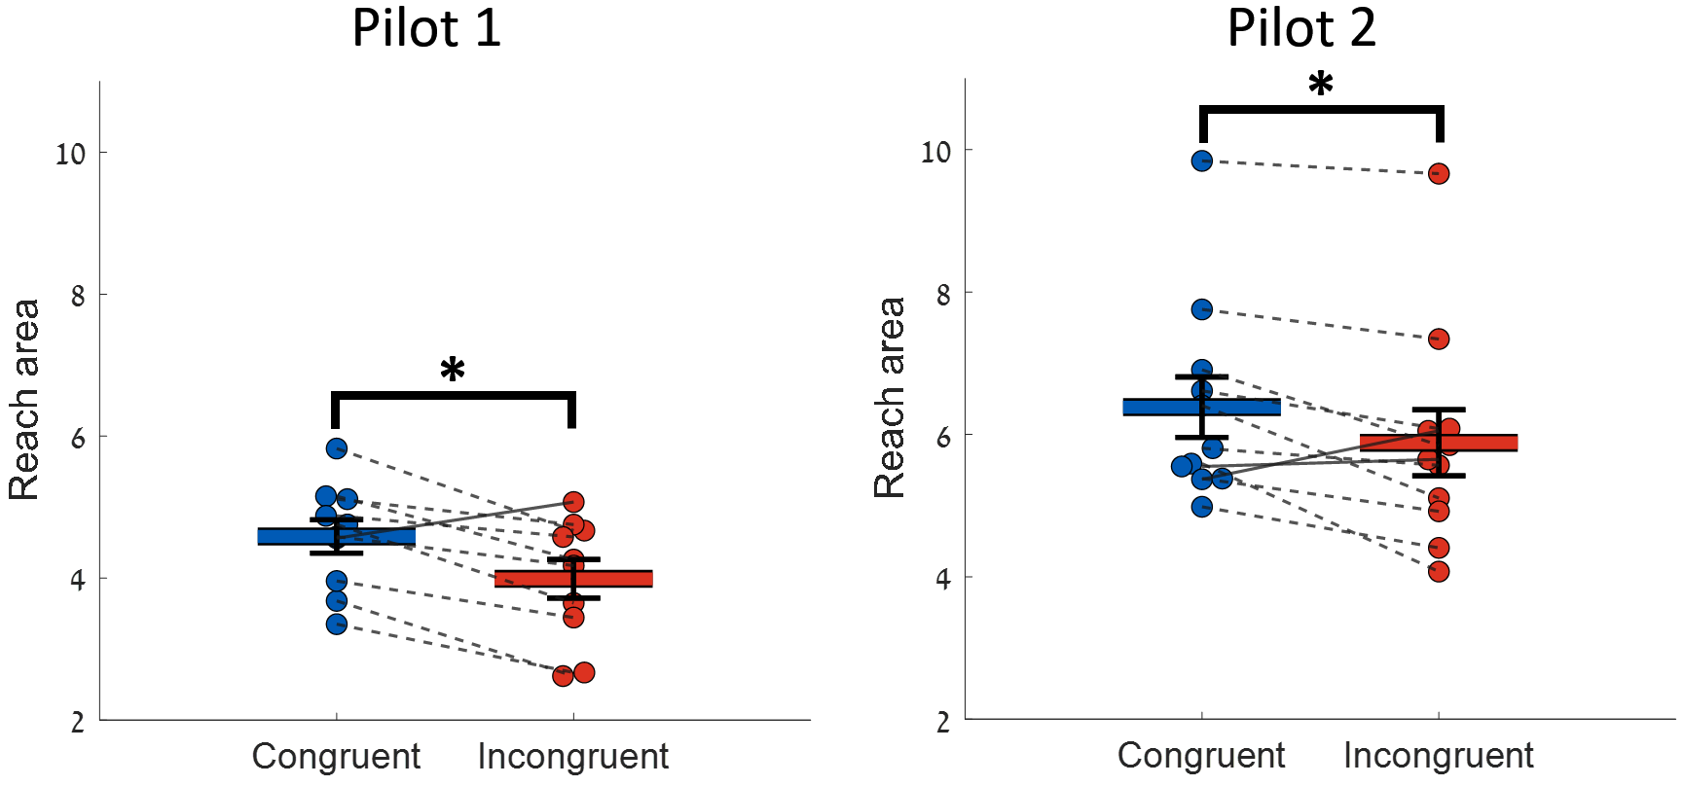
Reach Area
Pilot 2
Pilot 3

Slide 21
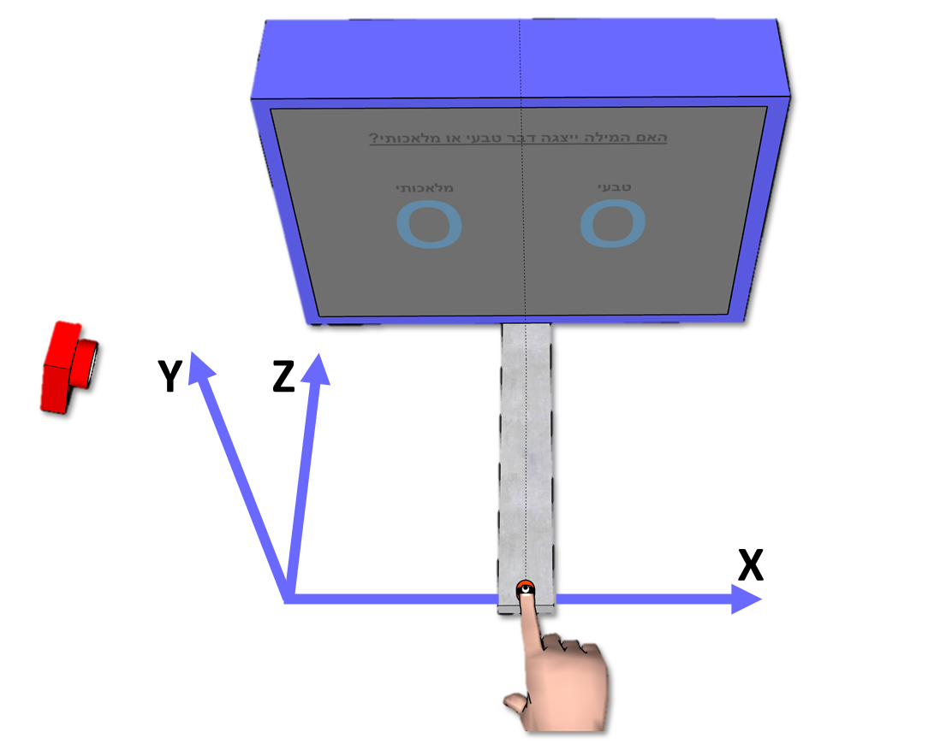
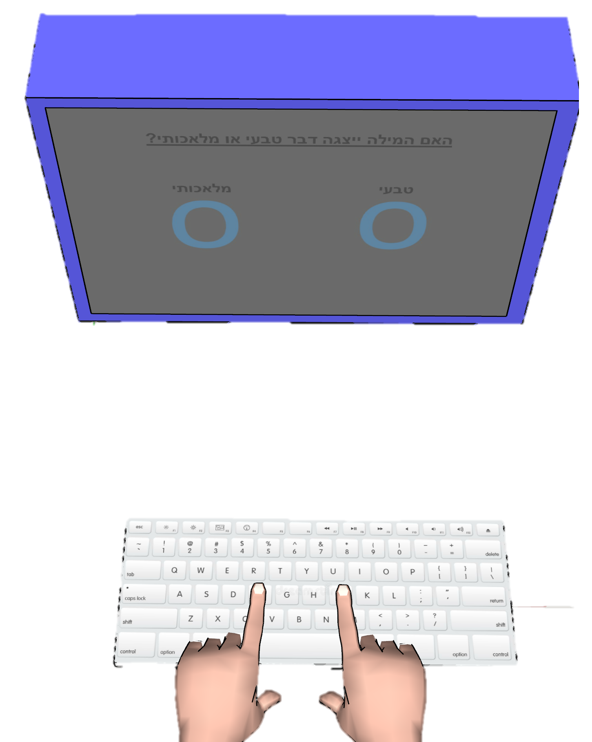
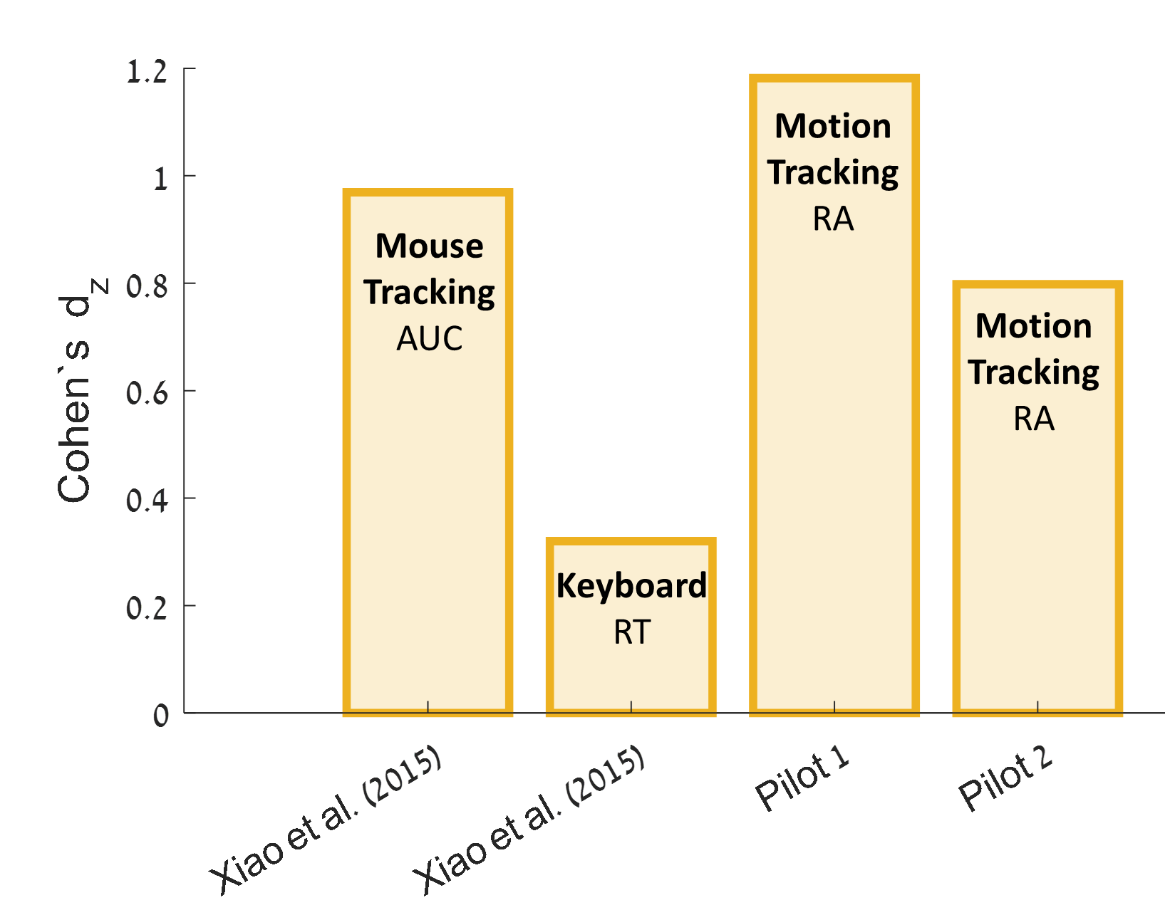
Next Experiment

Slide 22
Thank you for listening!

Slide 23
What is unconscious processing
Another difference is the signal strength – In order to render the stimuli unconscious we deteriorate its visibility.
There is a variety of ways to do so: diverting attention, surrounding it with stronger and more salient stimuli, displaying contradicting image to each eye…
The weaker signal leads to smaller unconscious effects.
This is a problem because it could make them undiscovereble.
One way to increase the effect size is to take advantage of more sensitive measures.
My research tries to validate motion tracking as a good measure for unconscious effects, which is also better than keyboard response.
Fd
In my experiment we used a priming paradigm, in which a prime word is displayed between two very salient masks.
This renders the prime invisible to the subject.
Afterwards a target word is displayed and the subject is asked to classify it as describing an artificial or natural item. EG radio is artificial.
Then the subject needs to recognize the prime between two distractor words.
And finally rate how well did he see the prime, 1=didn’t see anything, 4= saw clearly.
The subject responds on the categorization question by reaching and touching the correct answer on the screen.
While he does so, we track his movement, and extract its trajectory.
The prime and the target can be congruent = same word
Incongruent = different word from a different category, for example the prime would be Trees.
We would expect that when the prime is doesn’t match the target, this will hinder the subject’s response (show animation of traj to congruent and incongruent condition).
This difference between the response on the congruent condition and the uincongruent condition is called “the congruency effect”, and it represents the influence of the prime.
Exp 1
No results! ☹
Max RT = 1.5 sec
Why?
Drift diffusion?
The sub accumulates data. Since he has enough time he can initiate his decision after reaching the final response.
Plus, He has time to contemplate whether he chose the currect answer.
We never see the effect of the prime.
If we cut the RT shorter, subject will have to reduce the threshold of sufficient evidance.
This will allow unconscious effects to take place.
Since RT is shorter we should also add another training block.
And decrease screen dist.
We also increase target size, but why??? The effort of hitting a small target in such a short time might require high processing resources, which would leave a small mount for the unconscious processing.
Fail = Target duration wasn’t limited.
Exp 2
Subjects couldn’t deal with the fast RT. Many trials were disqualified due to late response, slow movmemnt.
Exp 3
Added another training day to improve RT.
Does this congruency effect actually happen in real life?
Yes it does (show graph of each response).
How do we quantify the difference between these trajectories?
We use reach area.
Reach area is the are between two average trajectories.
We calculate it for the congruent trials and the incongruent trials.
You can see it is smaller in the incongruent condition.
We conducted a statistical comparison between the reach area in the congruent condition and the incongruent condition and found a significant difference.
The effect size of this difference was similar to previous research that used unconscious processing and motion tracking, and is larger than the one that was found when using a keyboard.
If other have done it, why do we need to replicate? First of all replication is always blessed, secondly these previous studies had siome issues with their awareness manipulation.
Our next step would be to let every subject perform this experiment using a keyboard and using a motion tracking system and comparing their results.
According to previous findings and our pilots we are hoping to find an advantage for motion tracking.

Slide 24

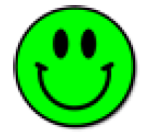
Unconscious processing
Conscious | Unconscious
 |  | Affects Behavior
 |  | Stimuli is Seen
 |  | Signal Strength

Slide 25

Unconscious processing
Stimuli
Perceived
Affects Behavior
Conscious
Weak Stimuli
Not Perceived
Affects Behavior
Unconscious
Happens when:
Weak stimuli Not perceived Affects behavior
Masking, CFS, attention…
Does it exist?
What capacity it has?
Isn’t it a byfact
Deteriorate the stimuli

